Slide 1
File Streams in C++
By Kyle Doidge

Slide 2
What is a file stream?
A generic term that normally refers to some particular syntax / code included in the language to perform some task
Firstly what is a stream?
A stream is an abstraction of a construct that allows you to send or receive an unknown number of bytes. (metaphor = stream of water).
Contrast this to an array for example, which has a fixed, known length.
* (So implementation of a stream would likely involve allocation of a larger space of memory than once thought necessary in order to process unknown amounts of data. Will likely also involve the reallocation of memory when more is needed)

Slide 3
So a file stream is a stream that works with files. The stream sends or receives unknown amounts of data across an external connection to a file.

Slide 4
The two file streams
The header for all filestreams is #include <fstream>
There is an input filestream: std::ifstream
This is used to get data from files
There is an output filestream: std::ofstream
This is used to output data to files.

Slide 5
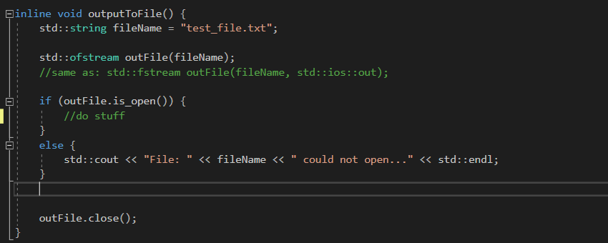
Opening and closing a file
To begin using a file, you must open it
Once you have finished, you must close the file (in order to deallocate the resources used by the filestream).

Slide 6
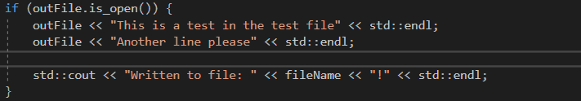
Writing to a file
After the file has been opened, you can WRITE (or read) to a file.
There are a number of commands for doing so, it may be of use to refer to this website
We are able to input and output the built-in data types using the stream extraction operator >> and the stream insertion operator << (for writing to a file we would use the stream insertion operator).

Slide 7
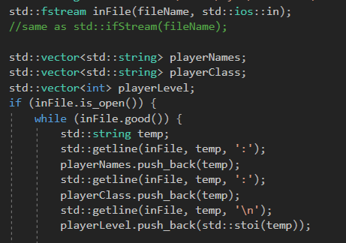
Reading from a file
After the file has been opened, you can READ data (or write) from a file.
There are a number of commands for doing so, it may be of use to refer to this website
We are able to input and output the built-in data types using the stream extraction operator >> and the stream insertion operator << (for reading to a file we would use the stream extraction operator).
You could also use std::getline(stream, string, delimiter) in order to extract data from the stream (ignoring delimiters), and place it in a string.

Slide 8
Binary files
Using structs (without packing / padding) in order to read and write from binary files is a common use of filestreams.
E.g. this is used when reading from bitmap files
It may be useful to research binary file in future projects

